Slide 1
User GUI
Custom Cuban chain links

Slide 2
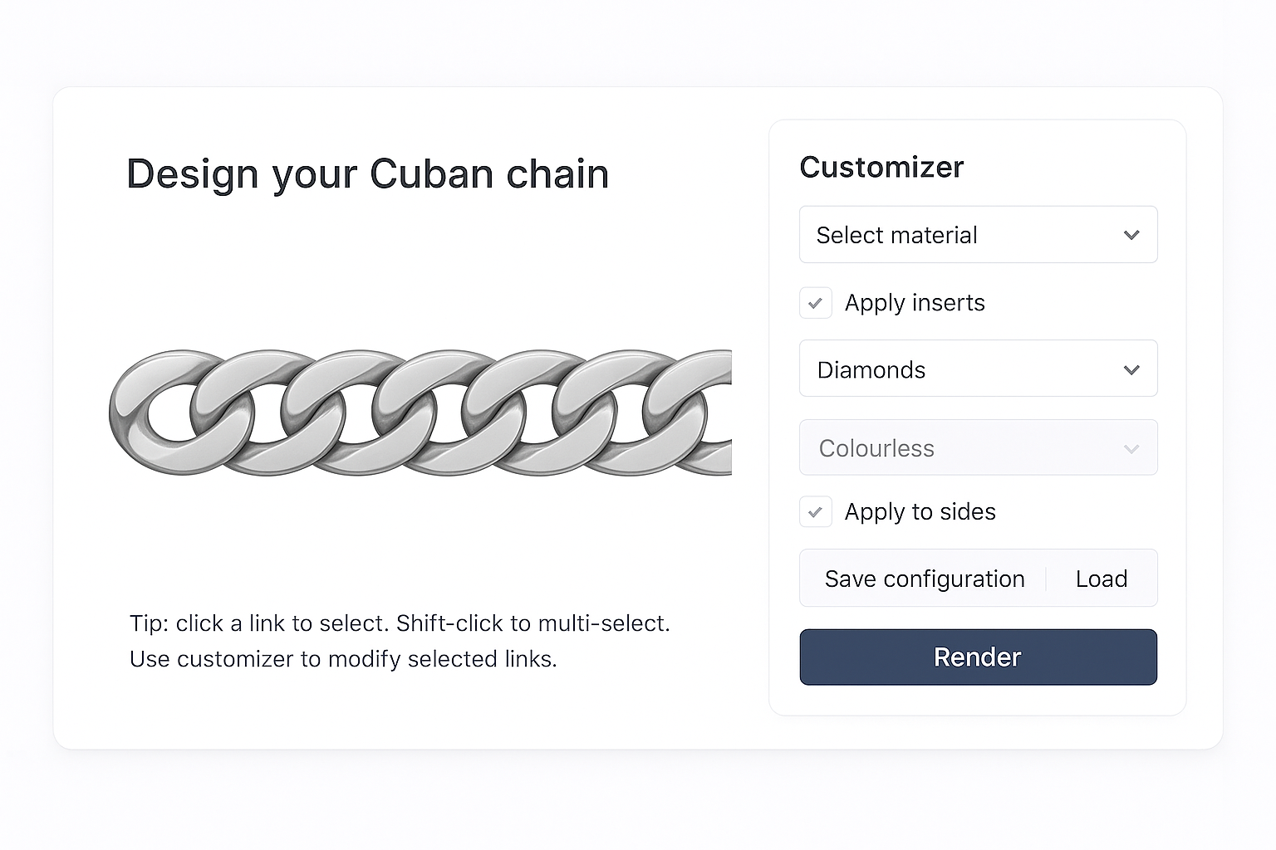
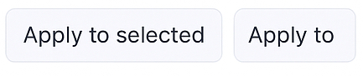
Diamonds:
Colourless
Moissanites:
Colourless
Black
Green
Red
Blue
Yellow
Orange
Rainbow1
Rainbow2
Enamel:
Black
White
Green
Red
Blue
Yellow
Orange
Opal 1
Opal 2
Engraving:
Pattern 1
Pattern 2
Options:
Silver
Gold
Grey
Black
Enables Drop down menus below
Enables Drop down menu below depending on selection
Tick to apply to sides
After configuration, click “apply to”, then click on the links
Apply to
Undo
Undo last application to a link
Done
Finish the configuration and close the configuration interface
Save and load code for the configuration

